Slide 1
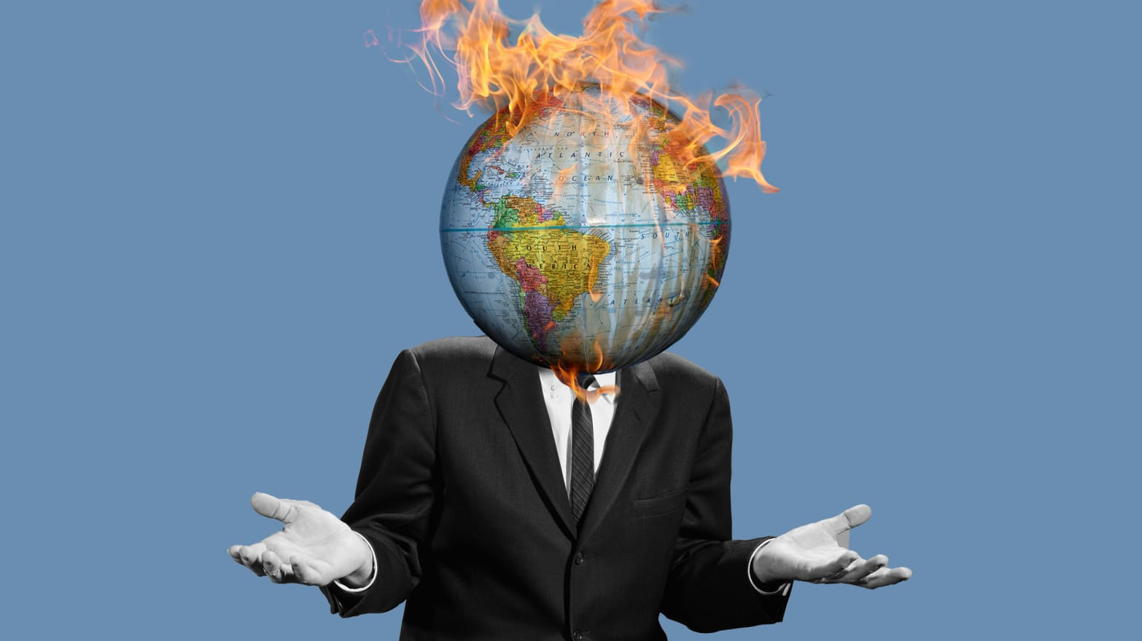
Notes:
Image retrieved from: https://www.thedailybeast.com/epa-on-un-climate-change-report-what-report-havent-heard-of-it
Slide note:
Hello everybody. Climate change has been at the top of our minds and at the forefront of political discussions today. Scientists are tasked to understand the ever changing atmosphere and they need help to better understand the clouds. Which will help them to demystify climate change.

Slide 2
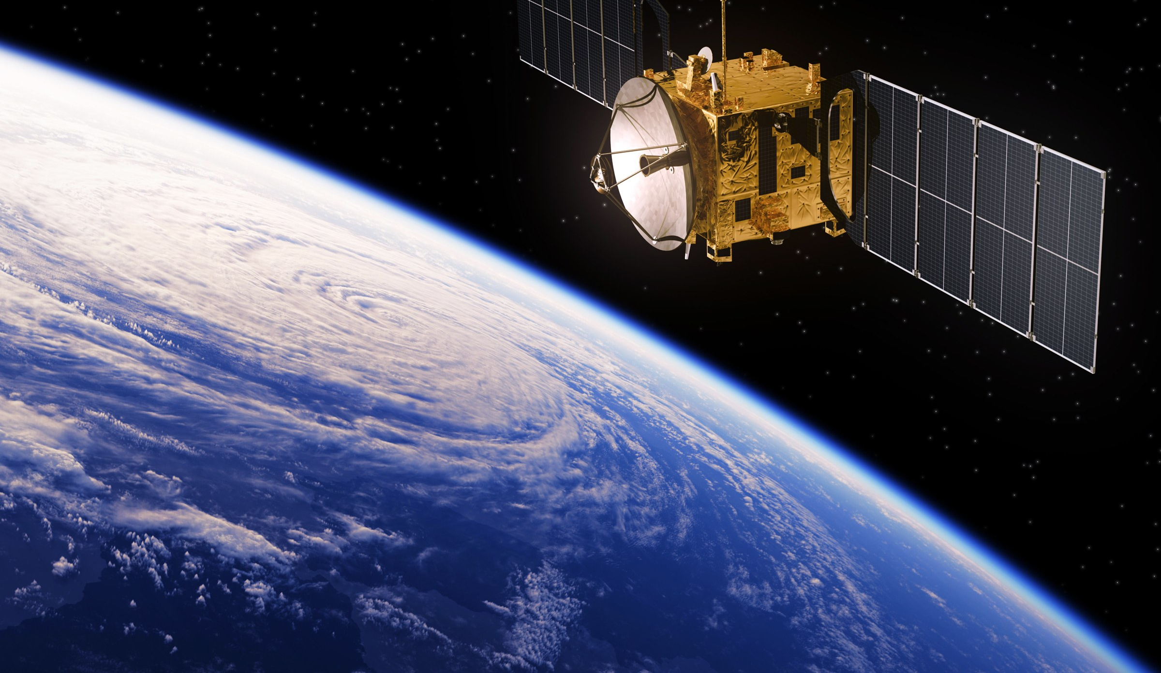
Understanding Cloud Organization from Satellite Images
DL 3546 – University Of Toronto – December 2019

Slide 3



THE TEAM
Rueen Fiez
Naresh Patel
Nisarg Patel

Slide 4
AGENDA
Problem
Key Findings
Solution

Slide 5
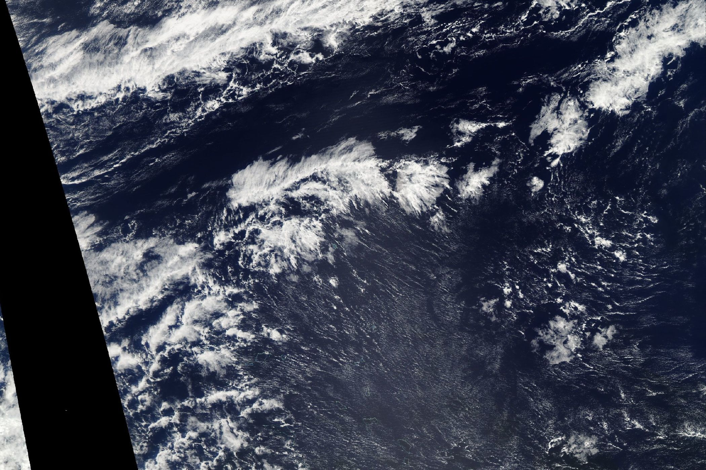
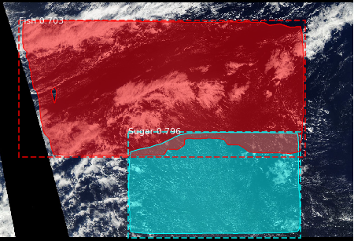
Problem Statement
Object Detection & Instance Segmentation

Slide 6
Problem Statement
Flower
ALL
Or
NONE
Fish
Gravel
Sugar

Slide 7
Solution – Dataset
Train Set
Test Set
5,546 images
train.csv (annotation file)
3,698 images
Model Train Set (80%)
Validation Set (20%)
4,436 images
1,110 images
USED
NOT USED
Dataset retrieved from https://www.kaggle.com/c/understanding_cloud_organization/

Slide 8
Solution – EDA

Slide 9
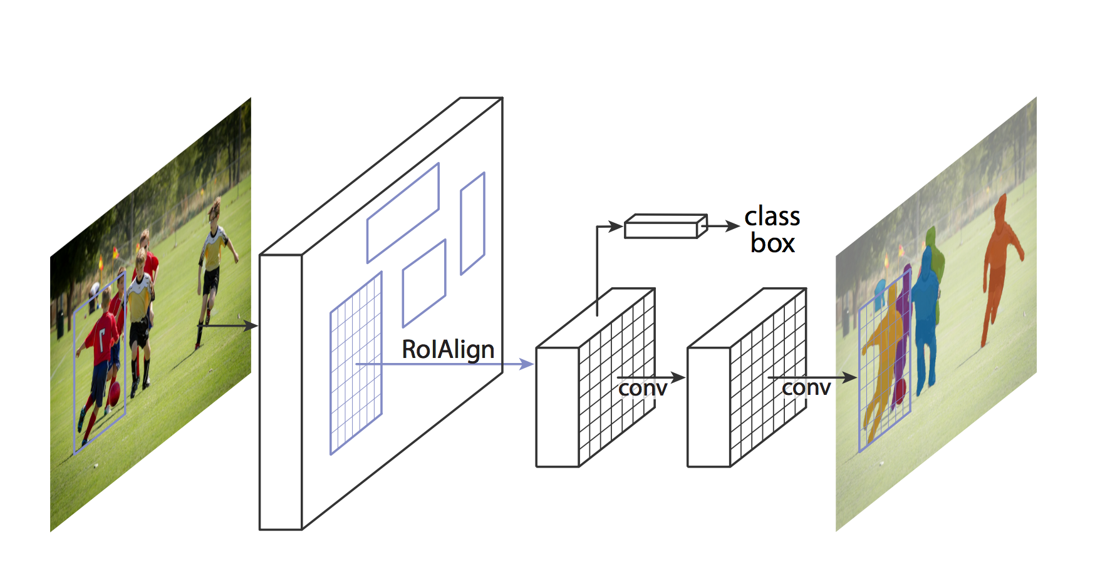
Solution – Model
Model: Mask R-CNN (Detection & Segmentation)
Weight: Coco
Image Dimension: 1400 x 2100 (H x W)
Steps Per Epoch: 2,218
Validation Steps: 555
Confidence: 70% (minimum)
Heads Layer Epoch: 1 (few as possible)
All Layer Epoch: 5 (Hardware limitations)
Training Time: ~16 hrs (Colab - GPU)
Evaluation Metric: Mean Average Precision (mAP)

Slide 10
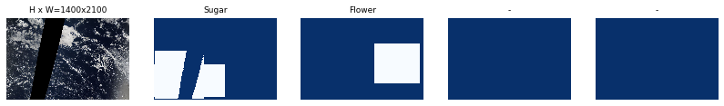
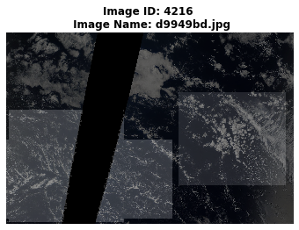
Solution – Image Mask

Slide 11
Solution – Journey
Split Data
Built Pipeline
Mask R-CNN Model
Train Model
Evaluate Base Model
Hyperparameter Tuning
Re-evaluate Model
Finalize

Slide 12
Key Outcomes
Produced a generalized model that detects and segments cloud types from a satellite image with a mean average precision (mAP) score of:
24.90 %
23.21 %
Train Dataset
Validation Dataset

Slide 13
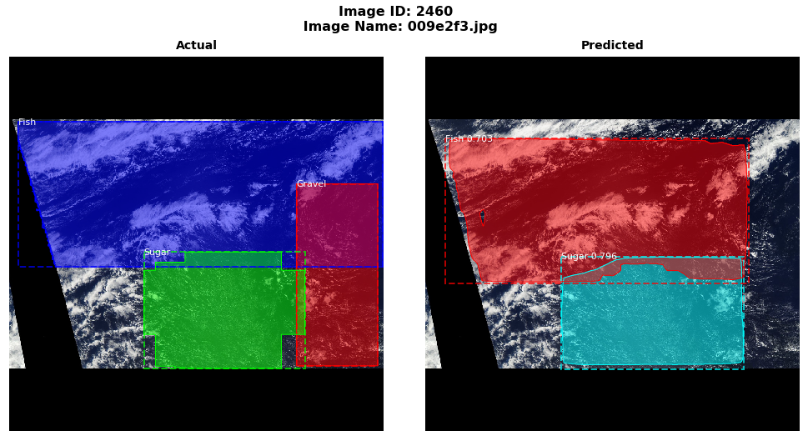
Key Outcomes

Slide 14
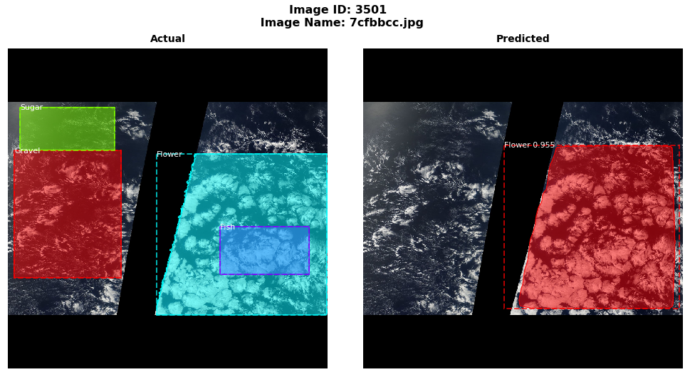
Key Outcomes

Slide 15
Next Steps
Train the model for more epochs (100)
Use Image Augmentation with pre & post processing
Experiment with different weights (Imagenet)
Experiment with different DL Packages (Py-torch) / Models (Faster R-CNN, U-Net)
Annotate images with segmentation masks

Slide 16


Thank You
https://github.com/nishp763/SCS-DL-3546-Final-Project
Notes:
Image retrieved from: https://depositphotos.com/113281806/stock-illustration-green-planet-earth.html

Slide 17
Appendix – Loss

Slide 18
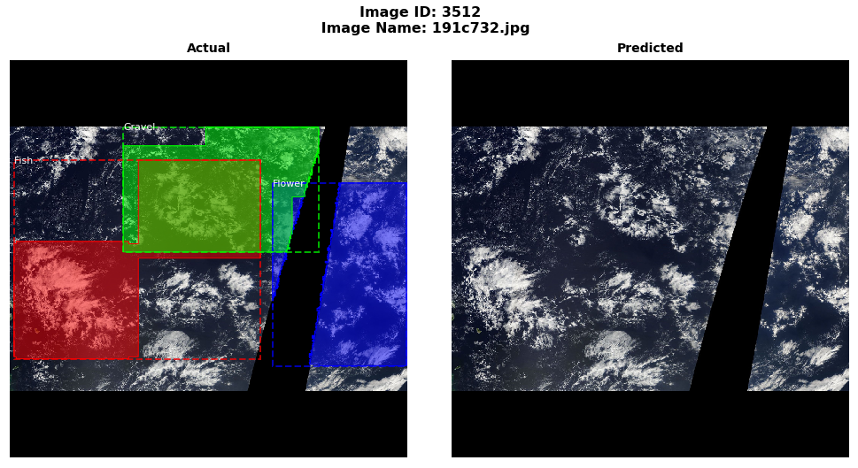
Appendix – No Detection

Slide 19
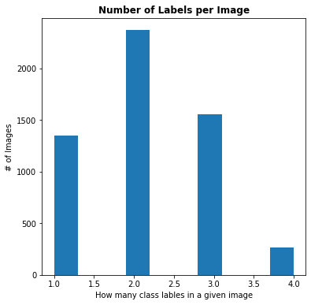
Appendix – Label Frequency

Slide 20
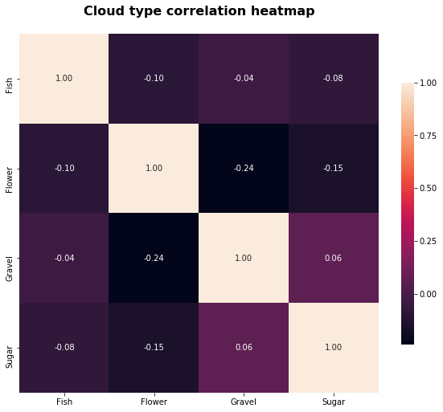
Appendix – Correlation

